Slide 1
Saline Lakes Land Ownership Visualizations

Slide 2
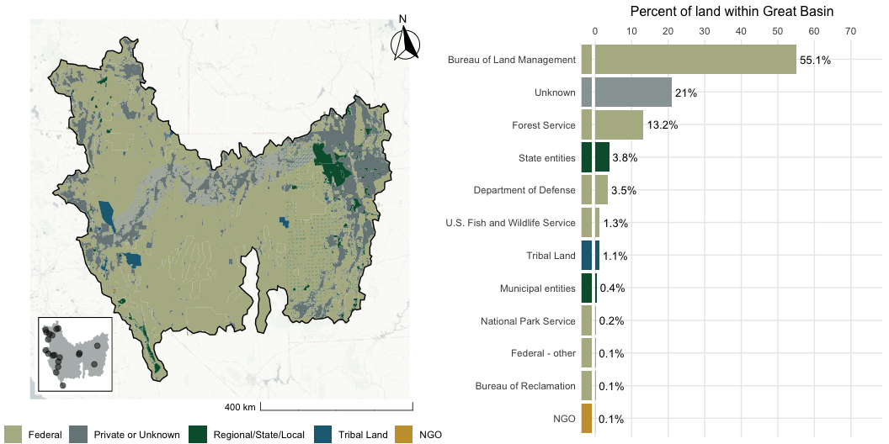
Great Basin

Slide 3
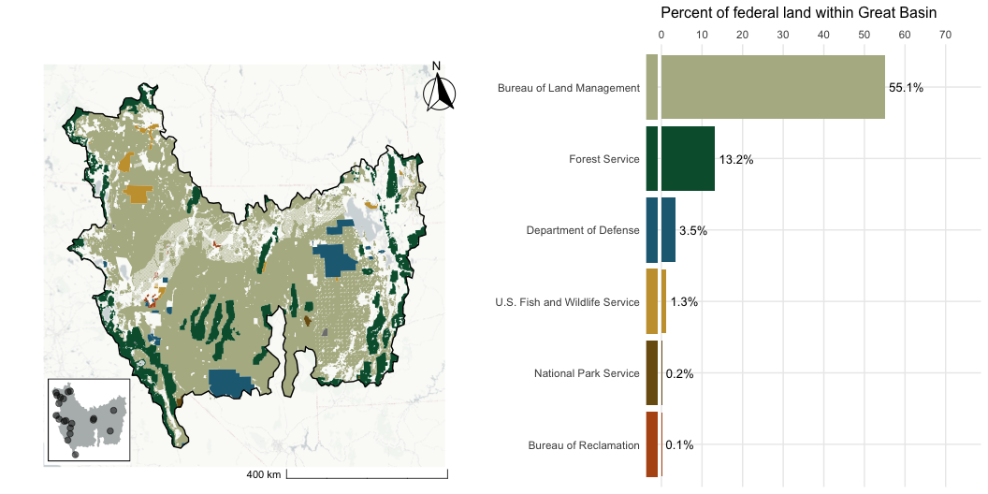
Great Basin - Federal Lands

Slide 4
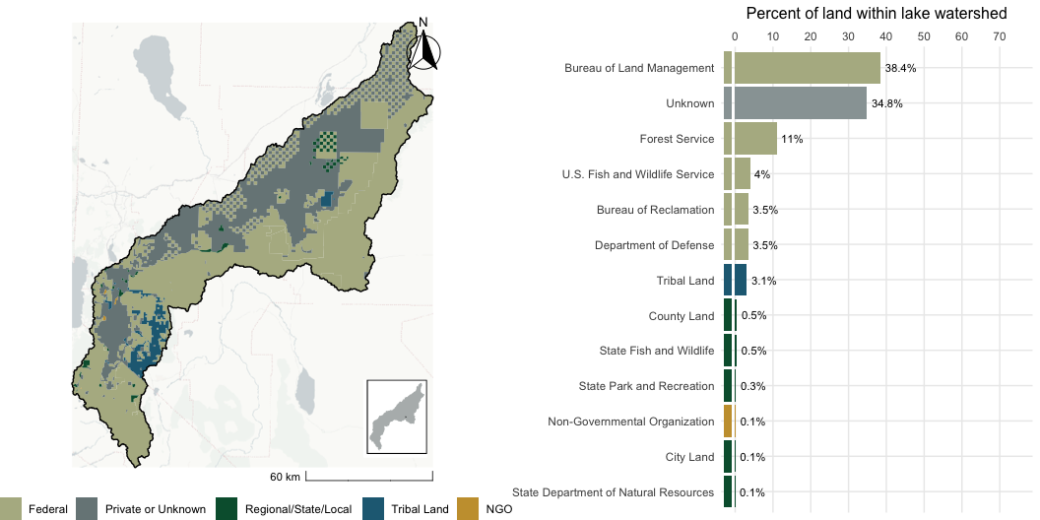
Carson Lake, NV

Slide 5
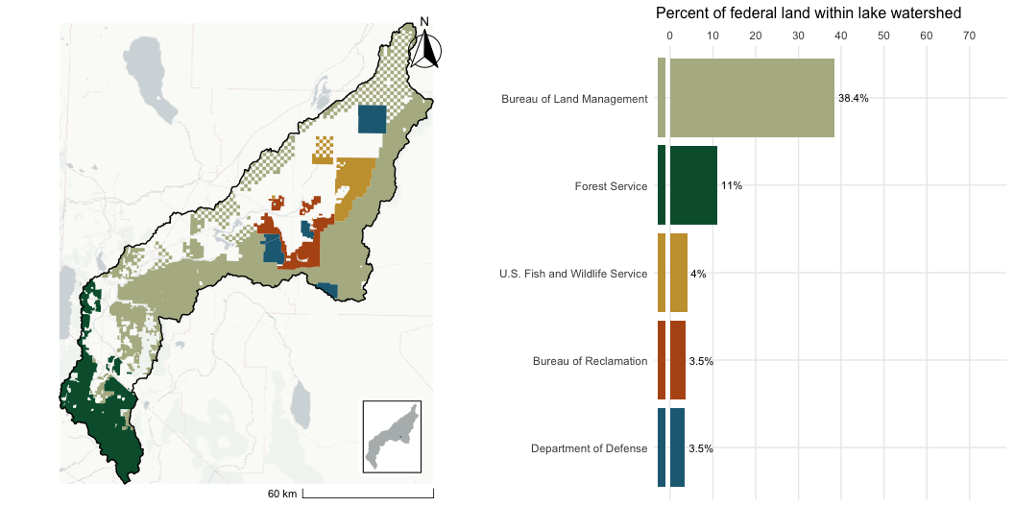
Carson Lake, NV - Federal Lands

Slide 6
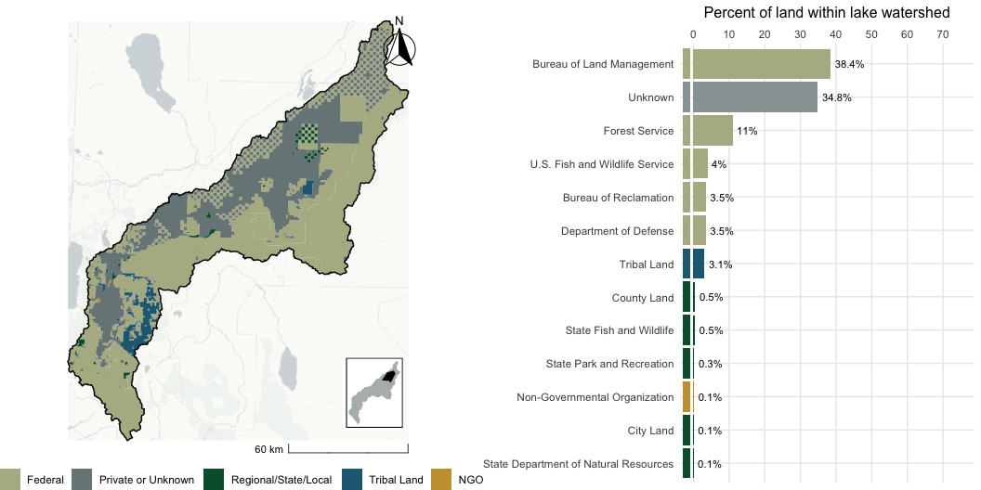
Carson Sink, NV

Slide 7
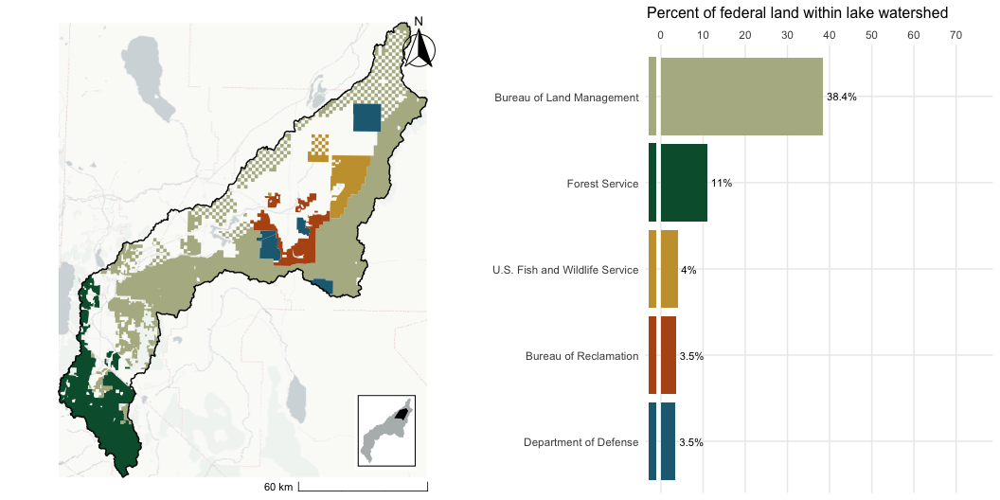
Carson Sink, NV - Federal Lands

Slide 8
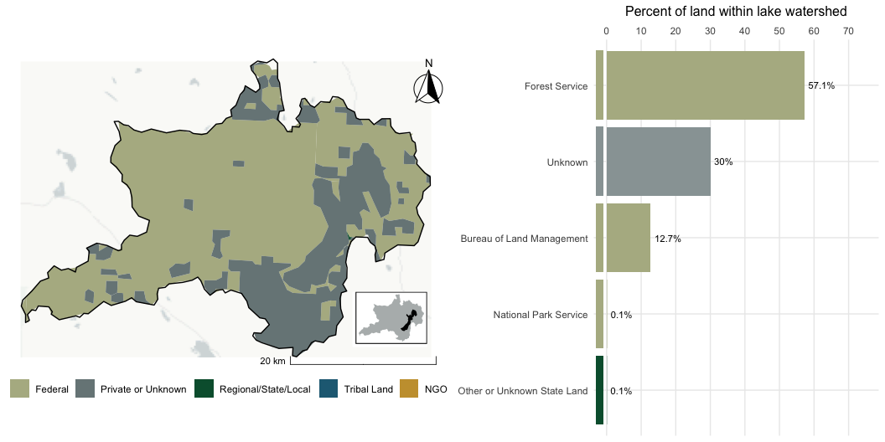
Eagle Lake, CA

Slide 9
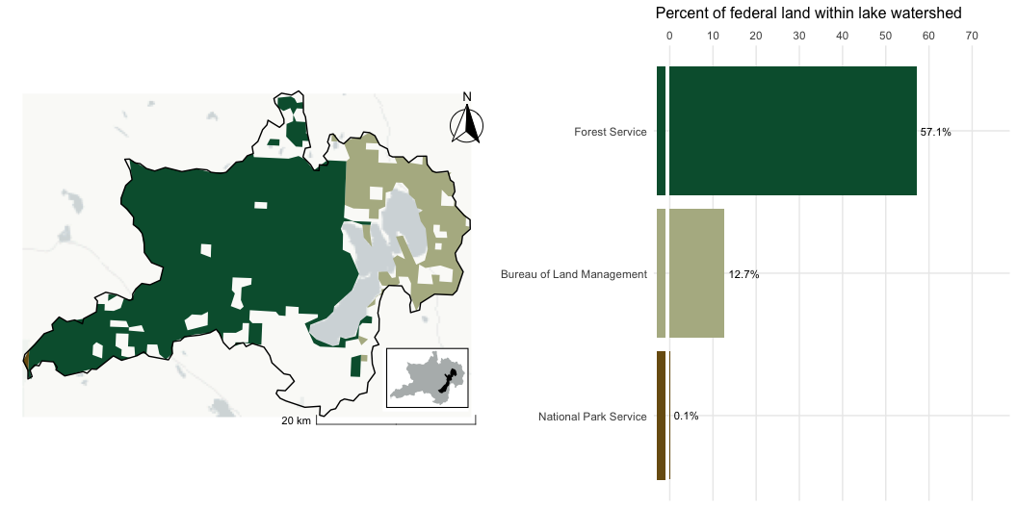
Eagle Lake, CA - Federal Lands

Slide 10
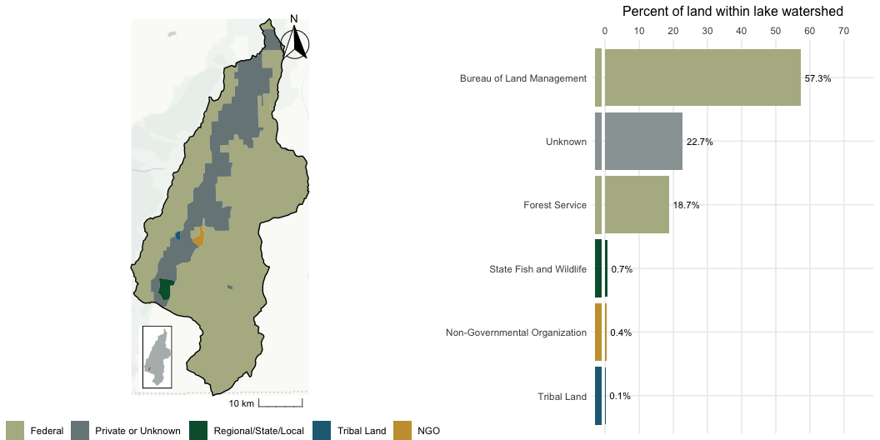
Franklin Lake, NV

Slide 11
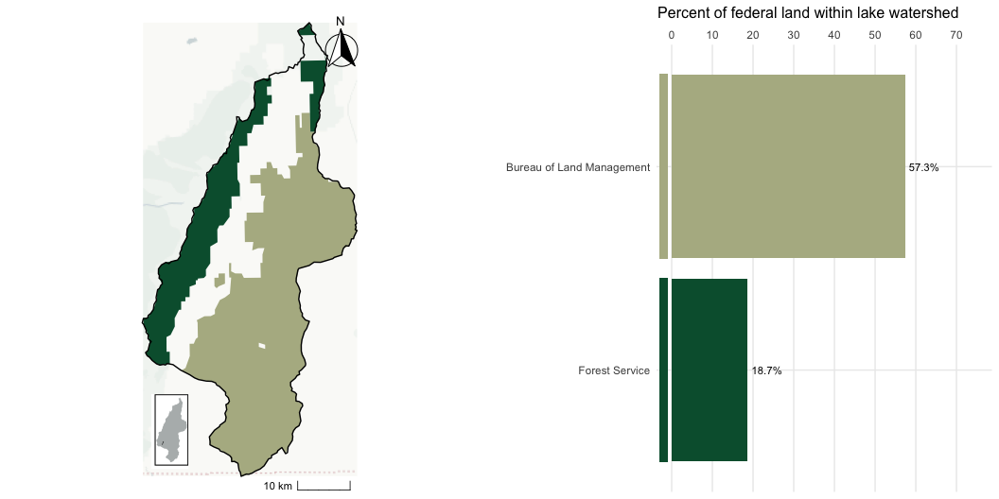
Franklin Lake, NV - Federal Lands

Slide 12
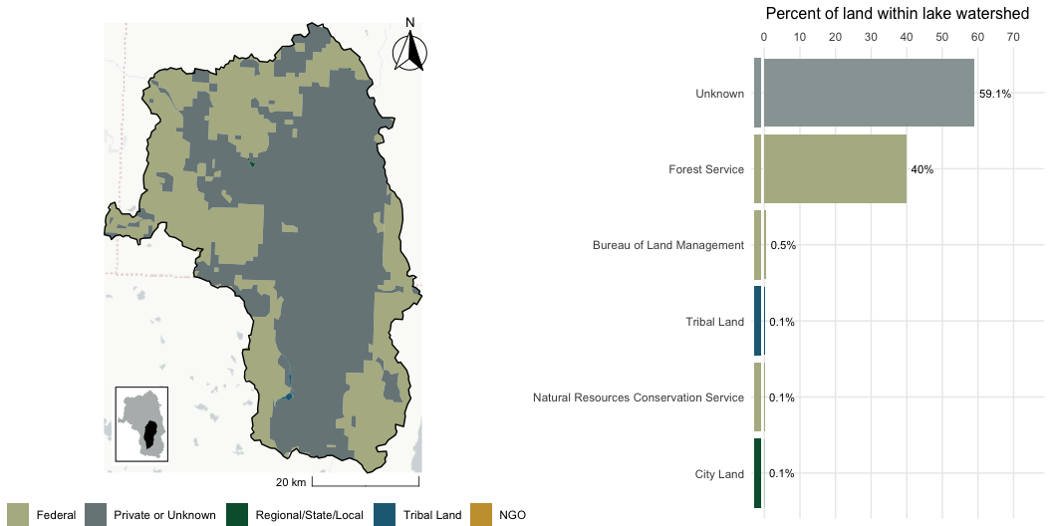
Goose Lake, CA

Slide 13
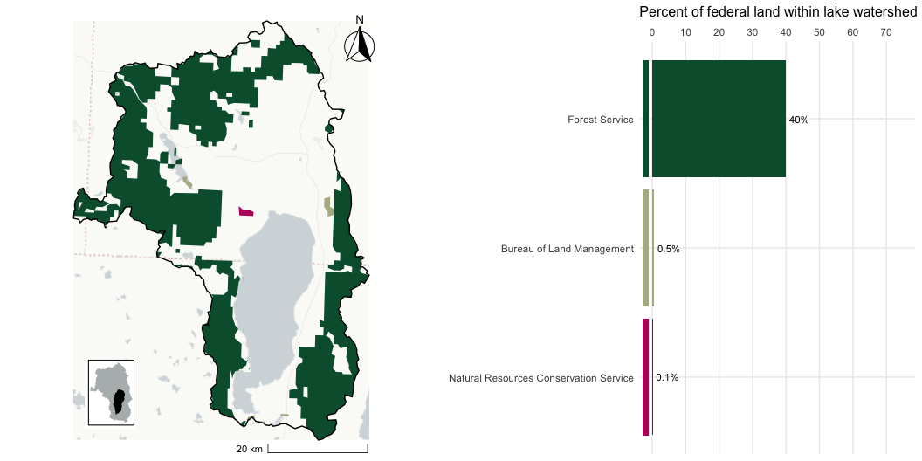
Goose Lake, CA - Federal Lands

Slide 14
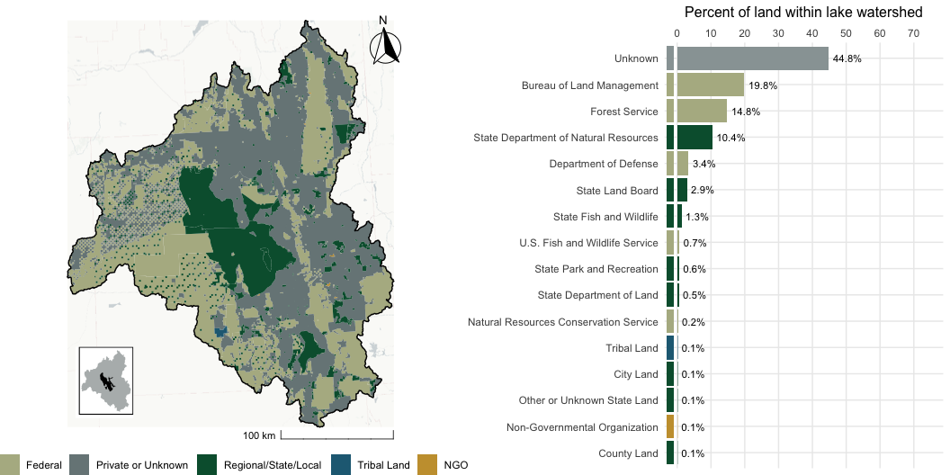
Great Salt Lake, UT

Slide 15
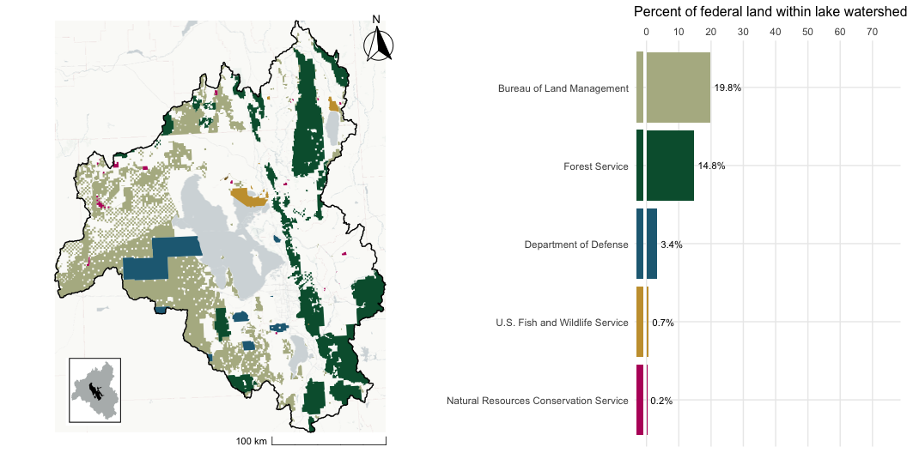
Great Salt Lake, UT - Federal Lands

Slide 16
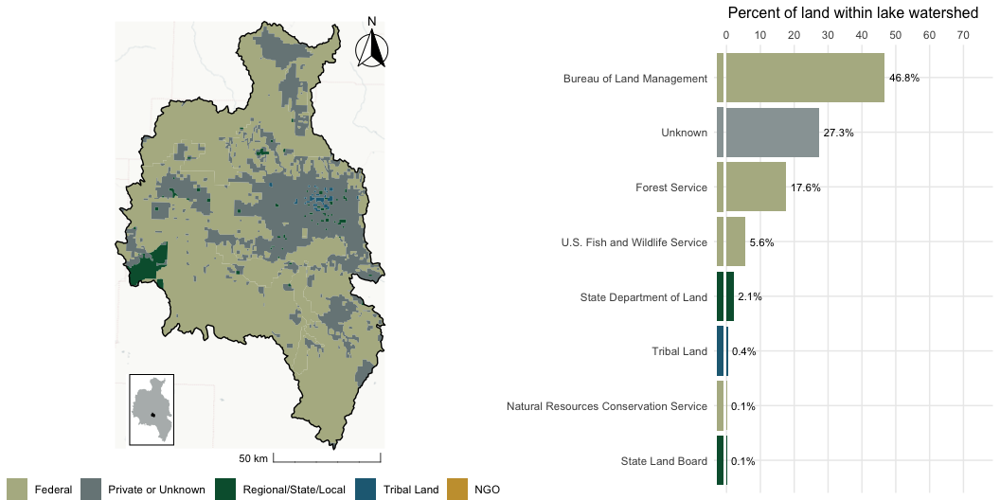
Harney Lake, OR

Slide 17
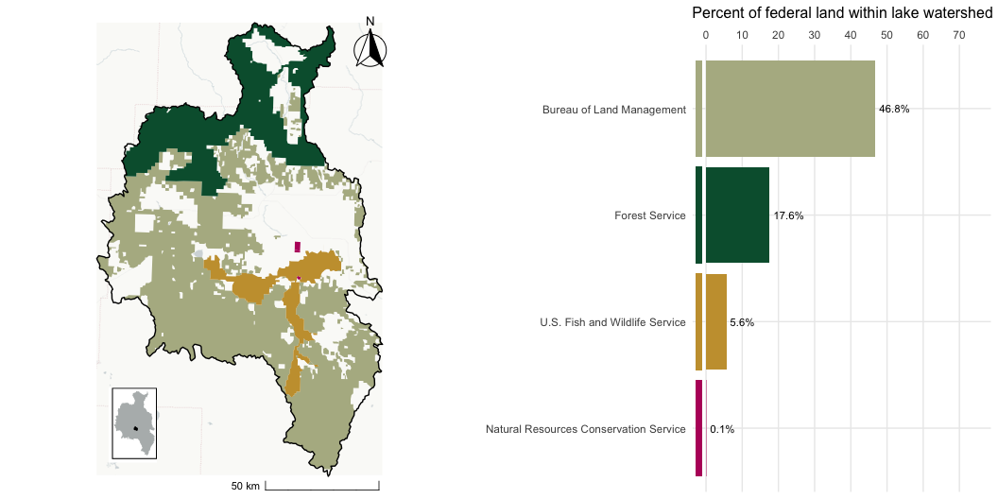
Harney Lake, OR - Federal Lands

Slide 18
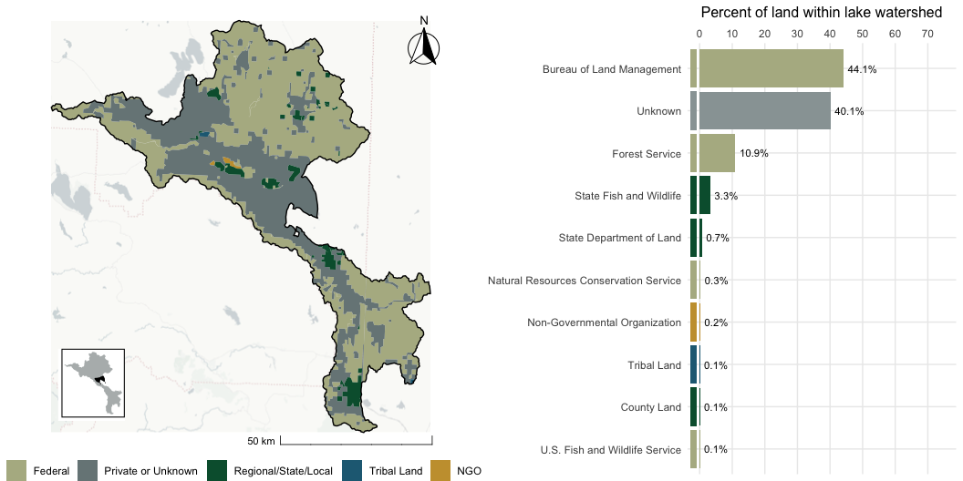
Honey Lake, CA

Slide 19
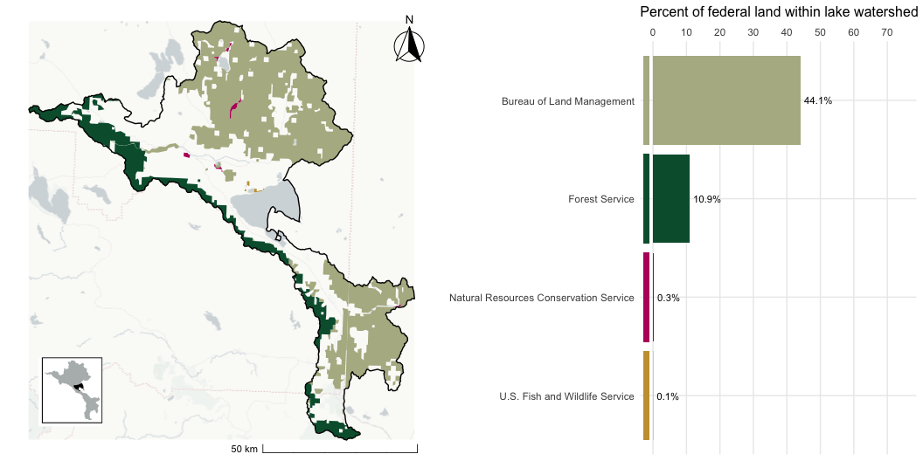
Honey Lake, CA - Federal Lands

Slide 20
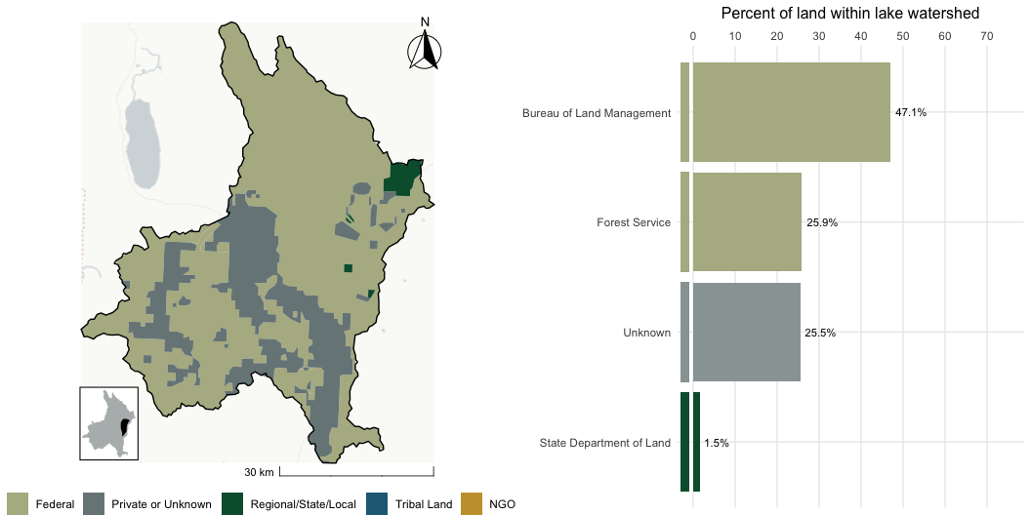
Lake Abert, OR

Slide 21
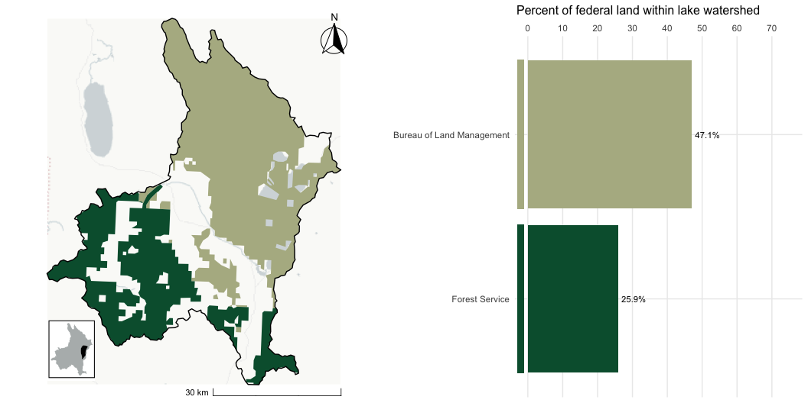
Lake Abert, OR - Federal Lands

Slide 22
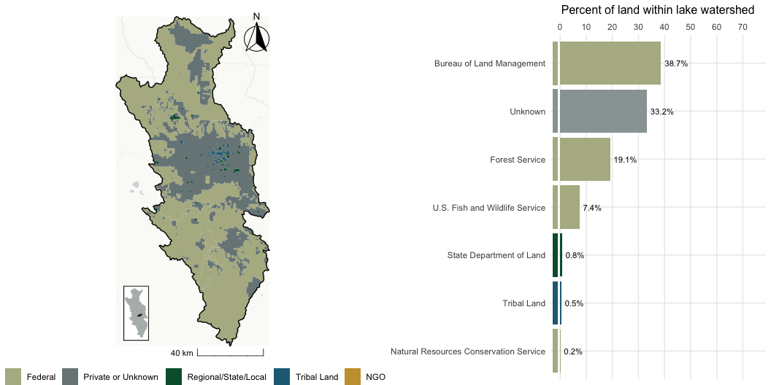
Malheur Lake, OR

Slide 23
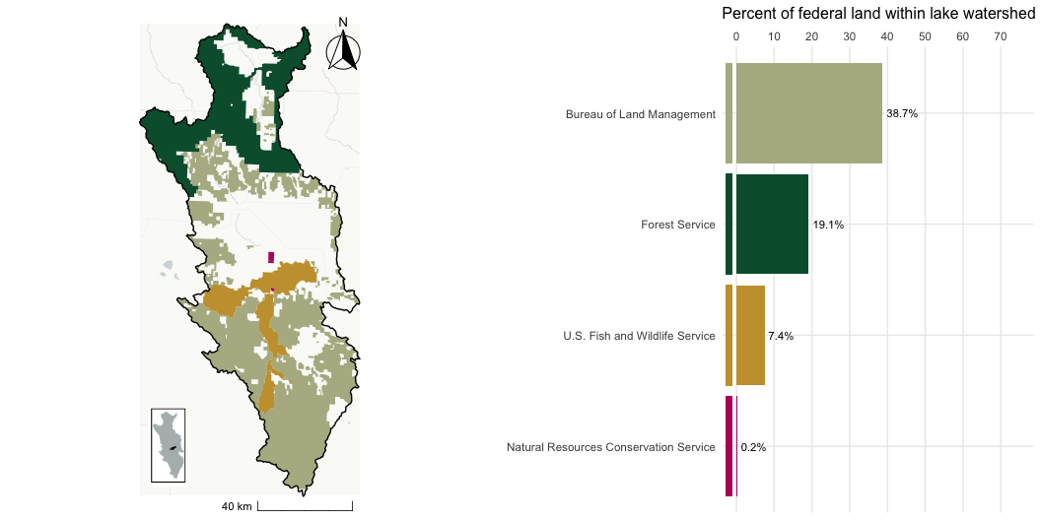
Malheur Lake, OR - Federal Lands

Slide 24
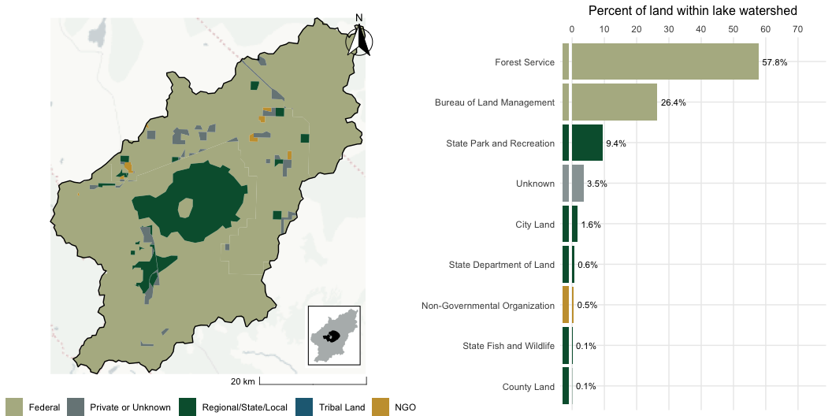
Mono Lake, CA

Slide 25
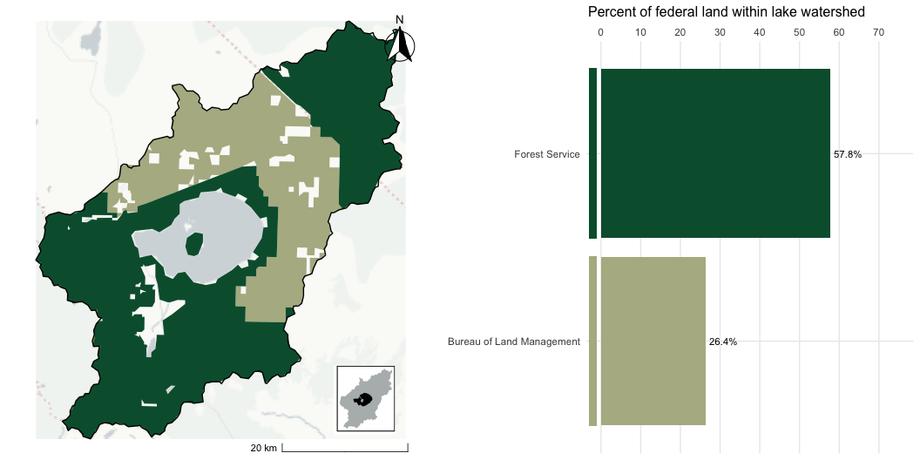
Mono Lake, CA - Federal Lands

Slide 26
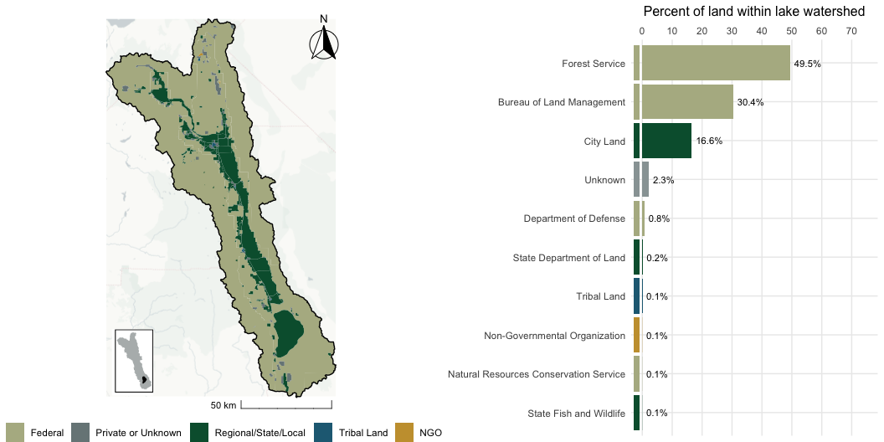
Owens Lake, CA

Slide 27
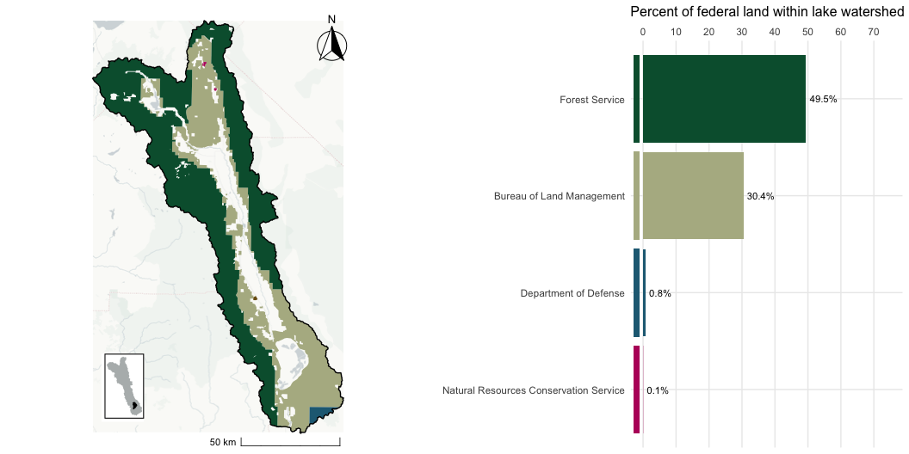
Owens Lake, CA - Federal Lands

Slide 28
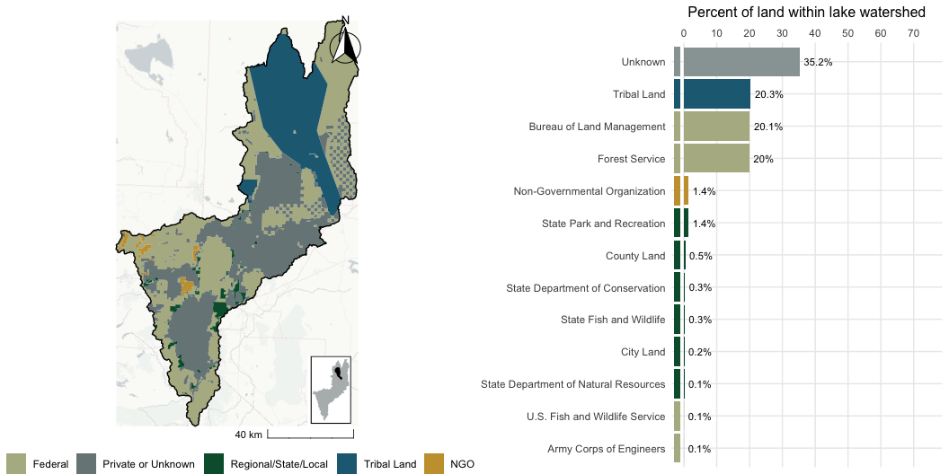
Pyramid Lake, NV

Slide 29
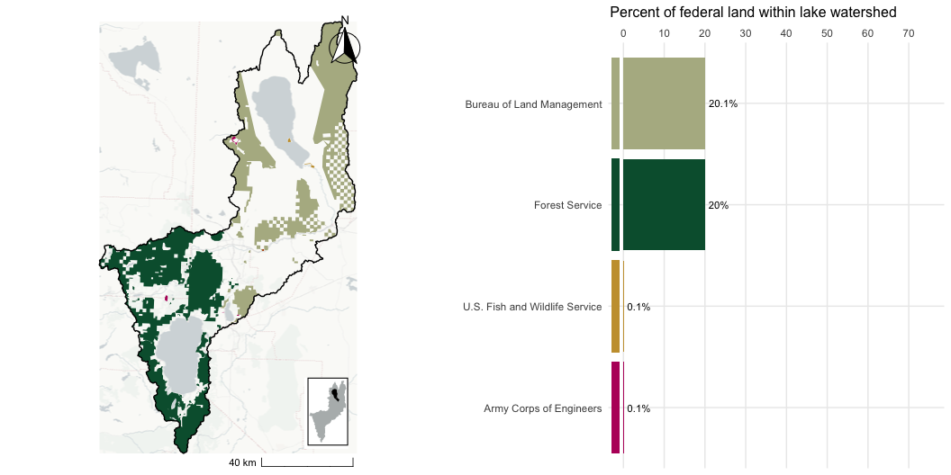
Pyramid Lake, NV- Federal Lands

Slide 30
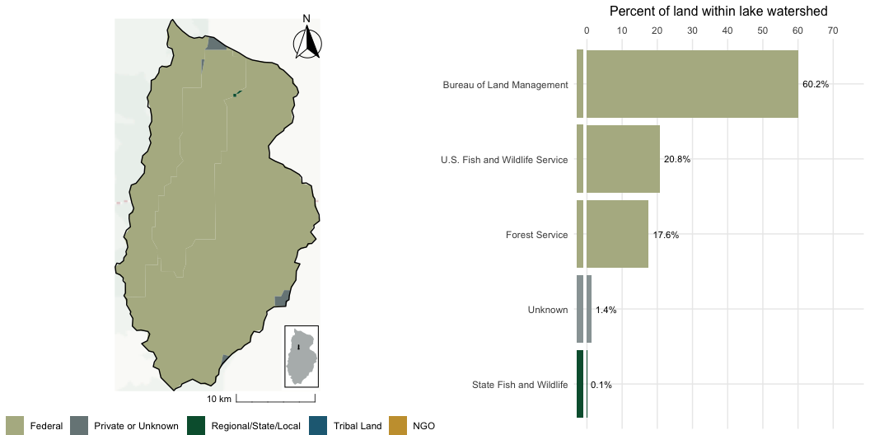
Ruby Lake, NV

Slide 31
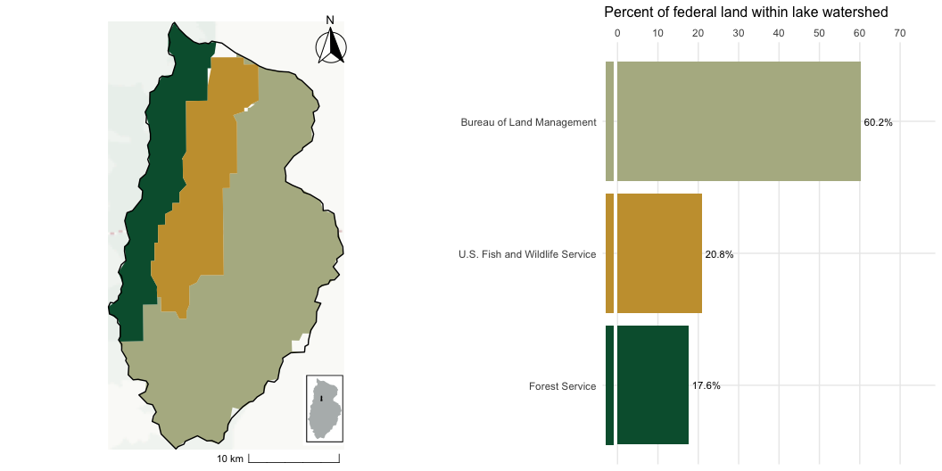
Ruby Lake, NV - Federal Lands

Slide 32
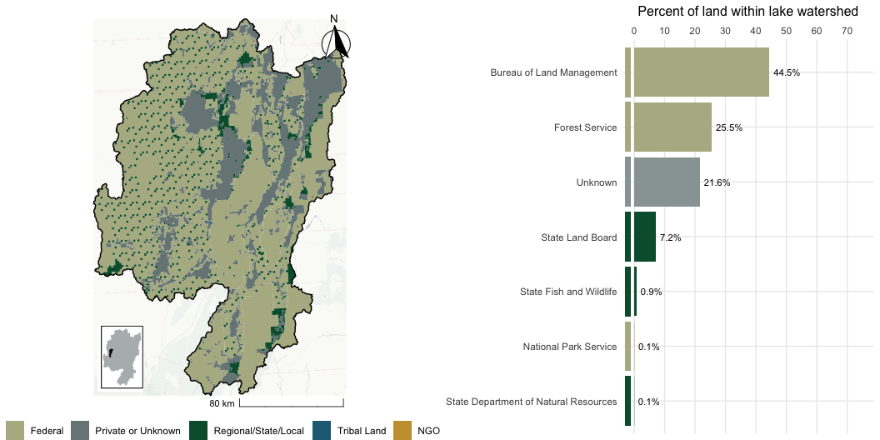
Sevier Lake, UT

Slide 33
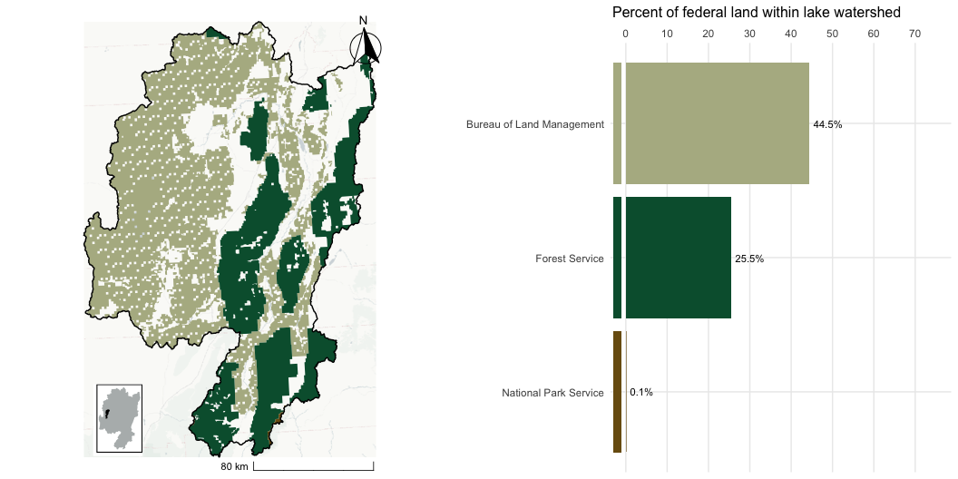
Sevier Lake, UT - Federal Lands

Slide 34
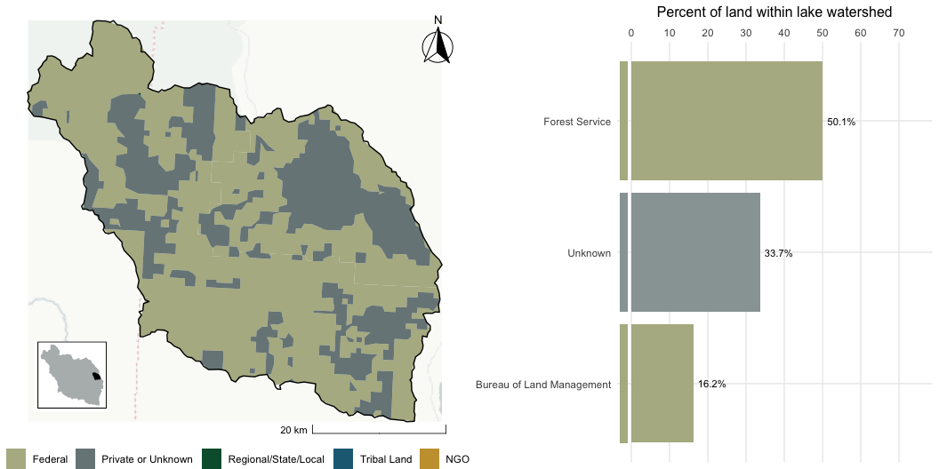
Silver Lake, OR

Slide 35
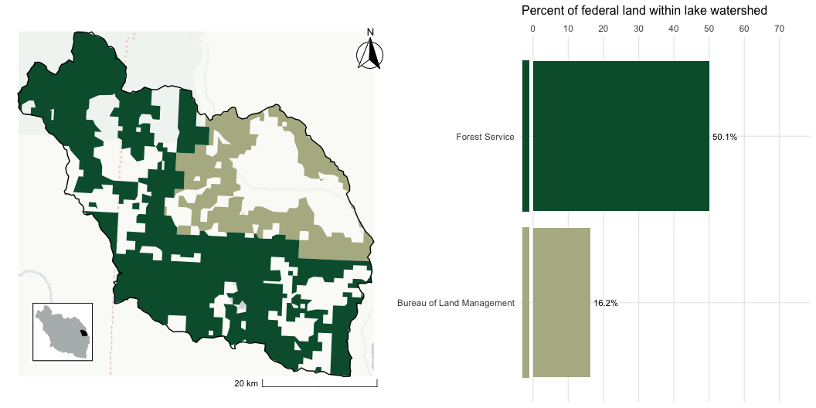
Silver Lake, OR - Federal Lands

Slide 36
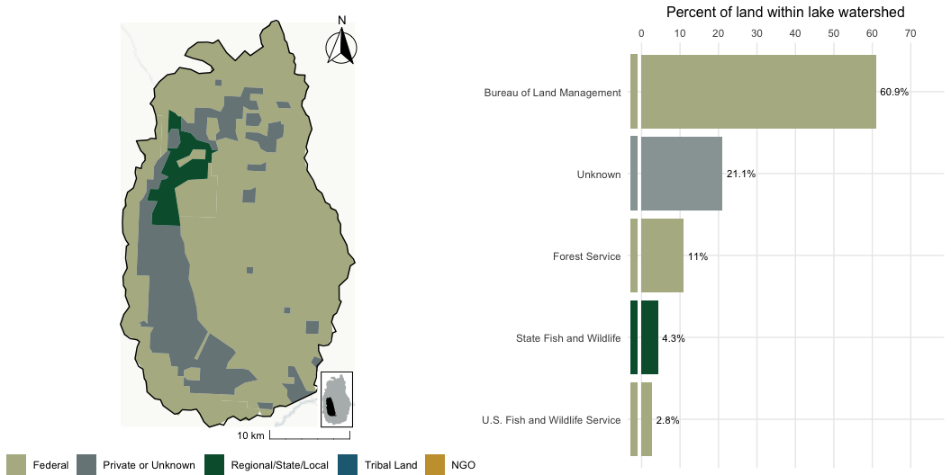
Summer Lake, OR

Slide 37
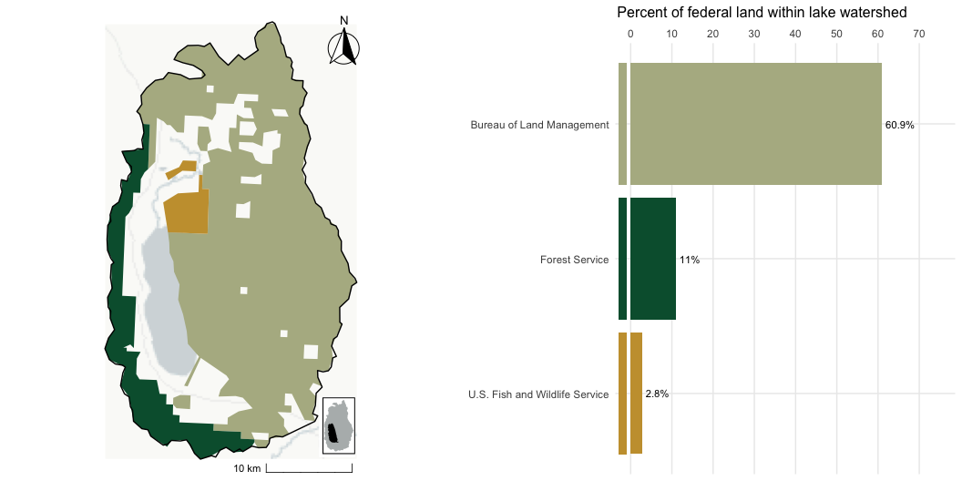
Summer Lake, OR - Federal Lands

Slide 38
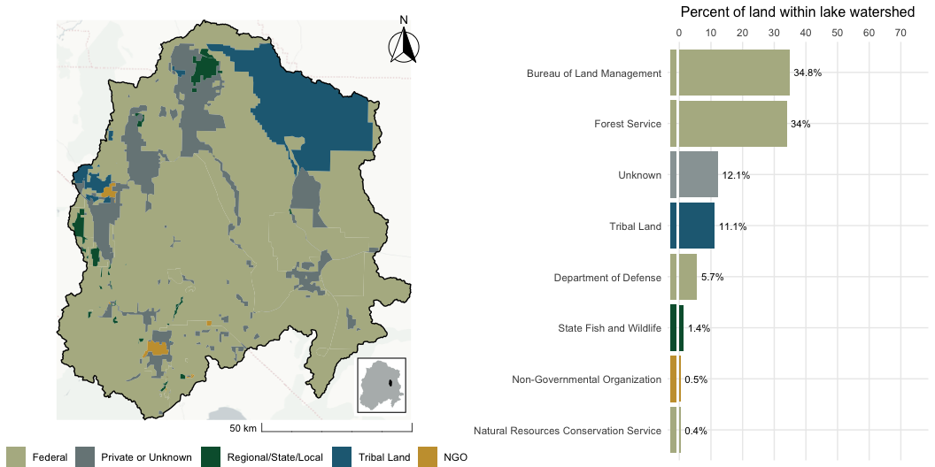
Walker Lake, NV

Slide 39
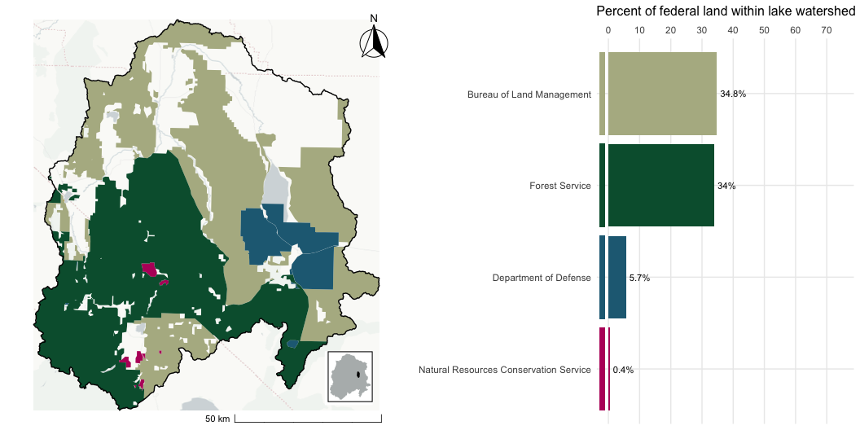
Walker Lake, NV - Federal Lands

Slide 40
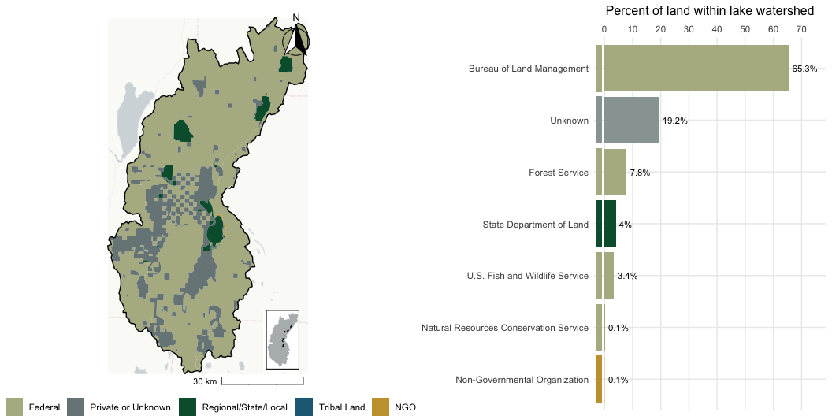
Warner Lake, OR

Slide 41
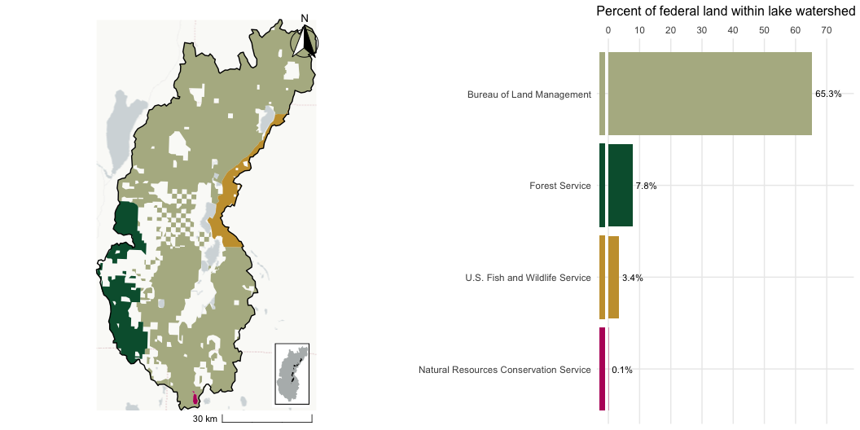
Warner Lake, OR- Federal Lands

Slide 42
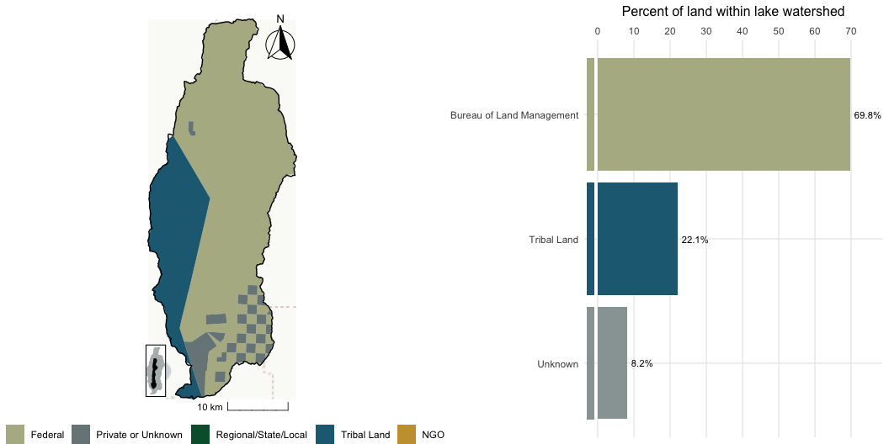
Winnemucca Lake, NV

Slide 43
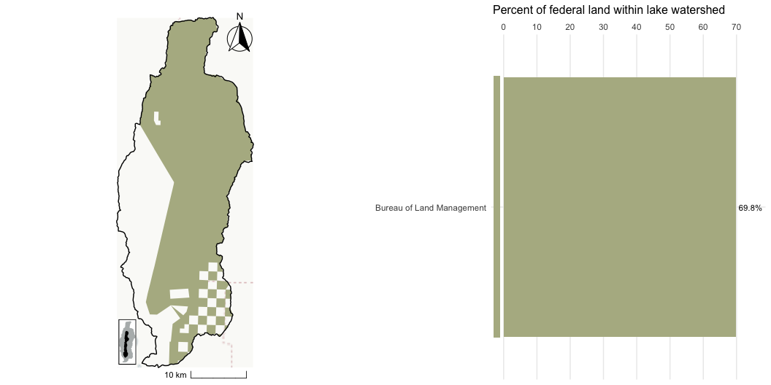
Winnemucca Lake, NV - Federal Lands

